Slide 1
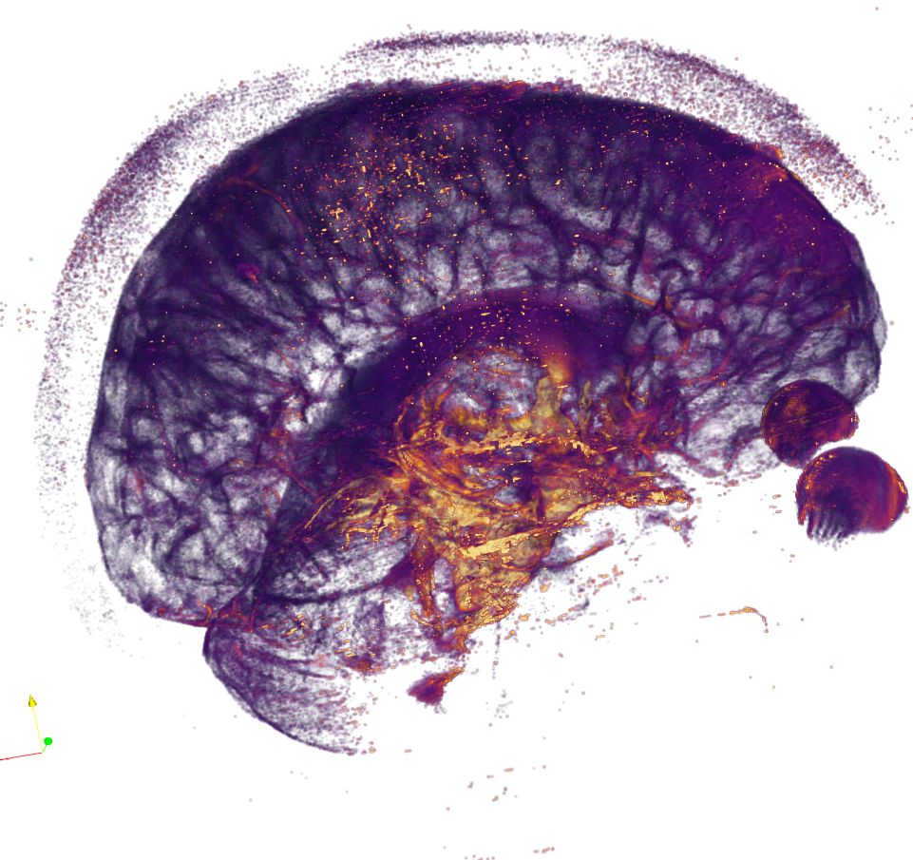
Quantitative T2 measurements of CSF-spaces and the relationship to CSF-STREAM
Nina Fultz

Slide 2
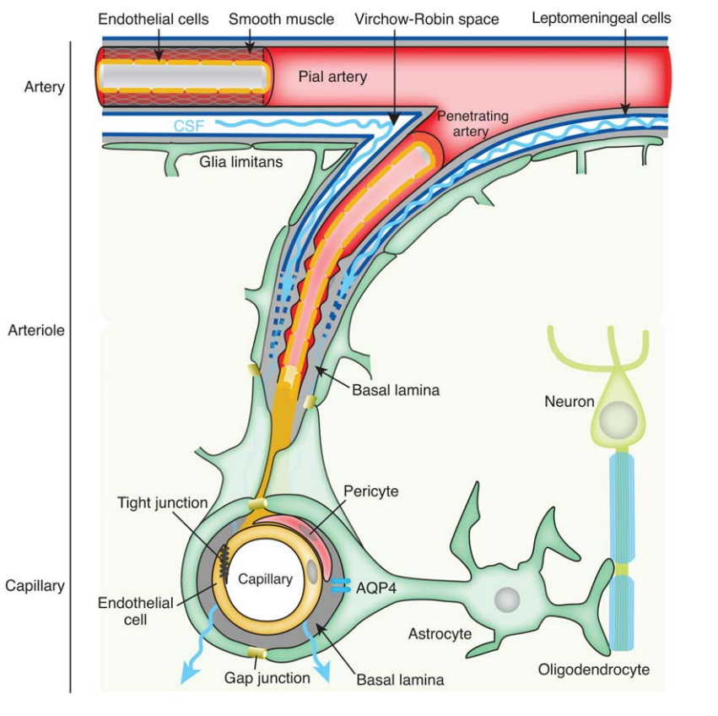
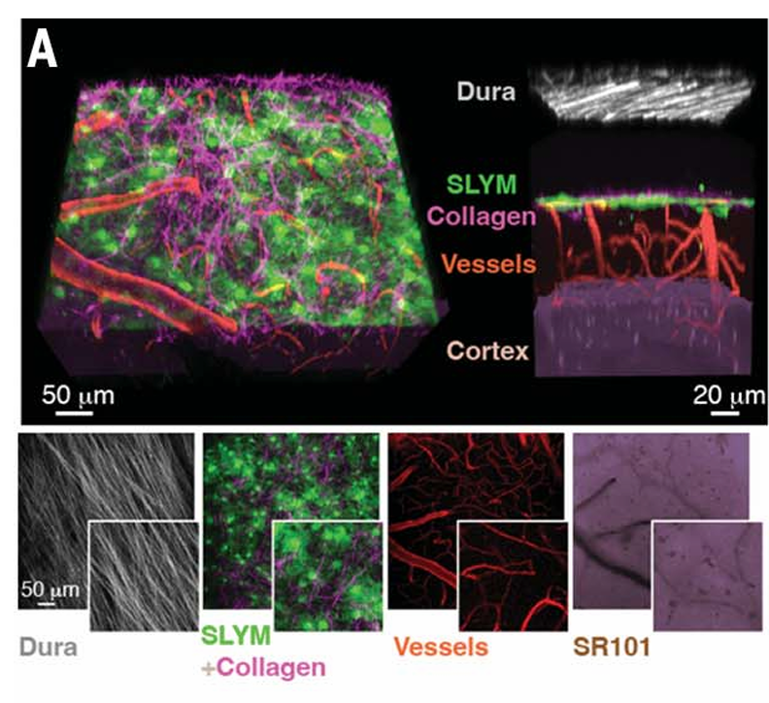
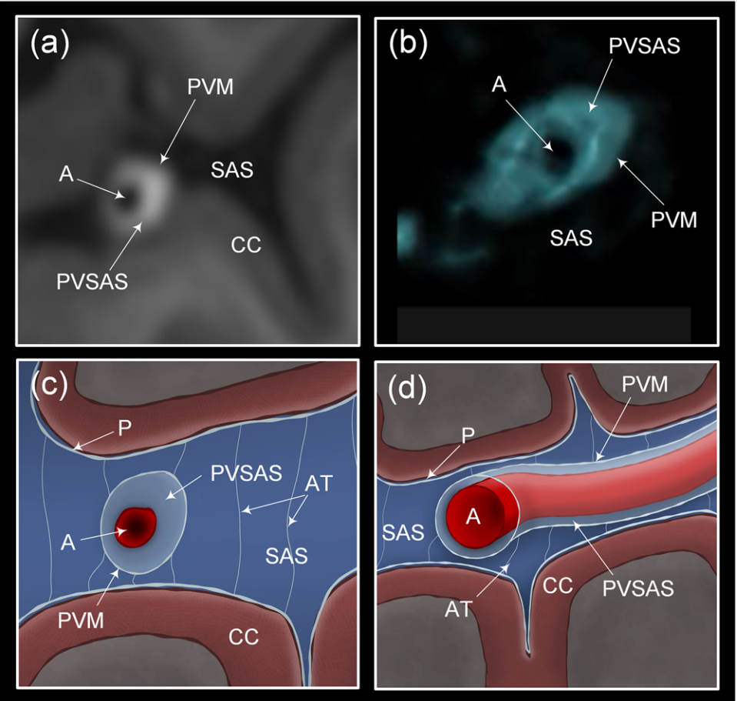
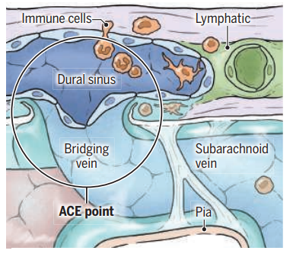
Are there CSF compartments?
Eide & Ringstad, 2024
Smyth et al., 2024
Aalling et al, 2015
Møllgård et al., 2023
Notes:
the glymphatic system is though to maintain cerebral homeostasis by circulating cerebrospinal fluid (CSF) through the brain via perivascular pathways that facilitate solute exchange between CSF and the interstitial fluid
CSF is thought to be created by the choroid plexus, and We have the lateral, third, and fourth ventricles where the CSF will move to as is moves away from the perivenous spaces

Slide 3
Are there CSF compartments?
Eide & Ringstad, 2024
Smyth et al., 2024
Aalling et al, 2015
Møllgård et al., 2023
Notes:
We show the existence of a fourth meningeal layer that compartmentalizes the subarachnoid space in the mouse and human brain, designated the subarachnoid lymphatic-like membrane (SLYM). SLYM is morpho- and immunophenotypically similar to the mesothelial membrane lining of peripheral organs and body cavities, and it encases blood vessels and harbors immune cells. Functionally, the close apposition of SLYM with the endothelial lining of the meningeal venous sinus permits direct exchange of small solutes between cerebrospinal fluid and venous blood, thus representing the mouse equivalent of the arachnoid granulations.

Slide 4
Are there CSF compartments?
Eide & Ringstad, 2024
Smyth et al., 2024
Aalling et al, 2015
Møllgård et al., 2023
Notes:
the glymphatic system is though to maintain cerebral homeostasis by circulating cerebrospinal fluid (CSF) through the brain via perivascular pathways that facilitate solute exchange between CSF and the interstitial fluid
CSF is thought to be created by the choroid plexus, and We have the lateral, third, and fourth ventricles where the CSF will move to as is moves away from the perivenous spaces

Slide 5
Are there CSF compartments?
Eide & Ringstad, 2024
Smyth et al., 2024
Aalling et al, 2015
Møllgård et al., 2023
Notes:
the glymphatic system is though to maintain cerebral homeostasis by circulating cerebrospinal fluid (CSF) through the brain via perivascular pathways that facilitate solute exchange between CSF and the interstitial fluid
CSF is thought to be created by the choroid plexus, and We have the lateral, third, and fourth ventricles where the CSF will move to as is moves away from the perivenous spaces

Slide 6
Do different CSF areas have different compositions due to waste?
Do we see CSF ‘donuts’ beyond the ACA, PCA, and MCA?
Do these donuts have changes in composition and mobility around major arteries and bridging veins/ACE points?

Slide 7
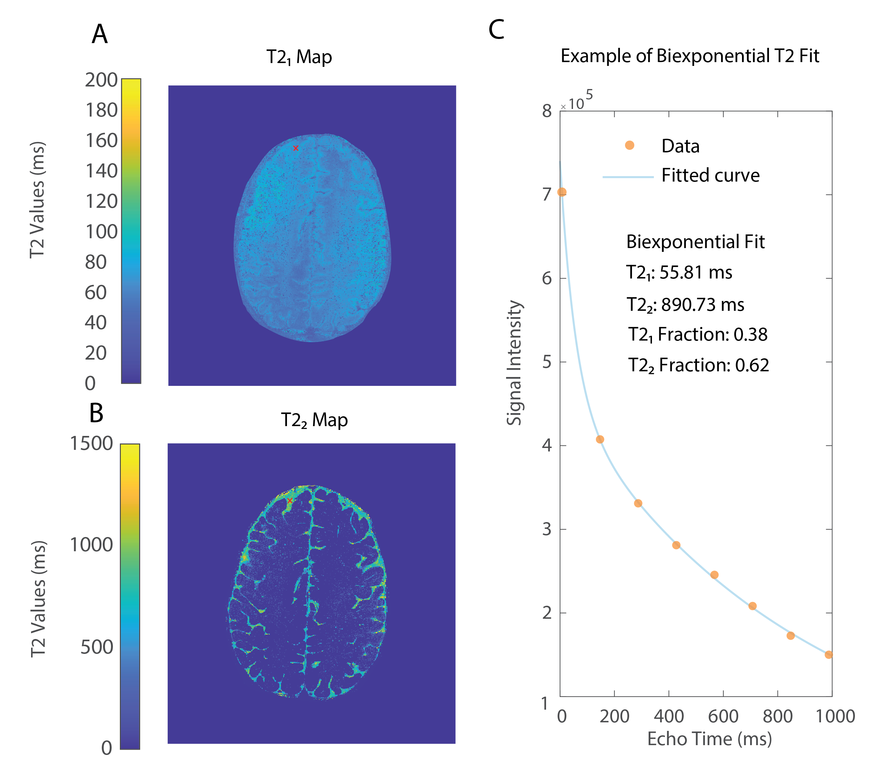
T2 Mapping
Hirschler et al., under review

Slide 8
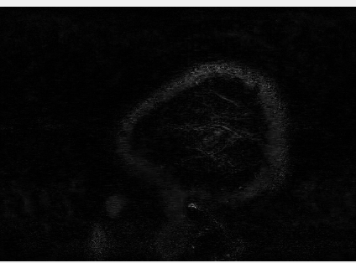
CSF-STREAM
T2 Mapping
Hirschler et al., under review

Slide 9
Do CSF areas have different compositions due to waste?
Do these compartments have different CSF mobility and T2 values around major arteries and bridging veins/ACE points?

Slide 10
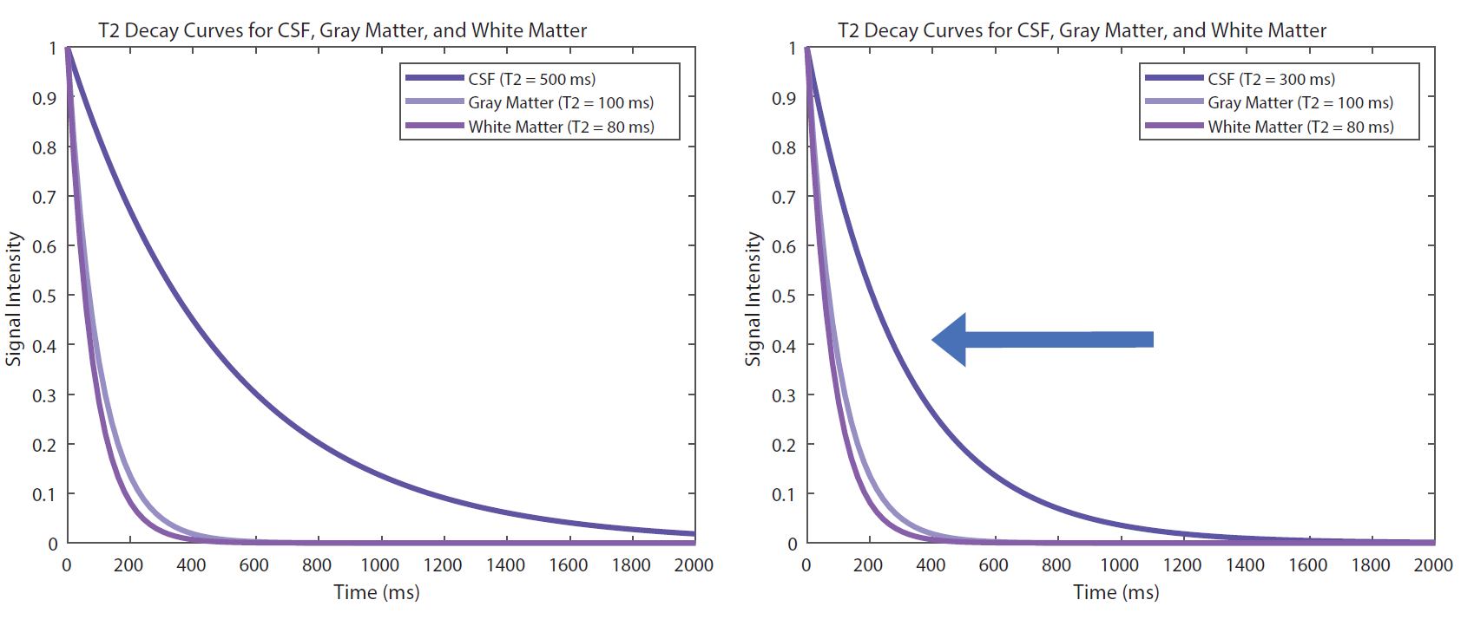
Previously we have used longer echo times to examine CSF (~500 ms)

Slide 11
However, we have found that lower echo times = increase CSF visualization

Slide 12
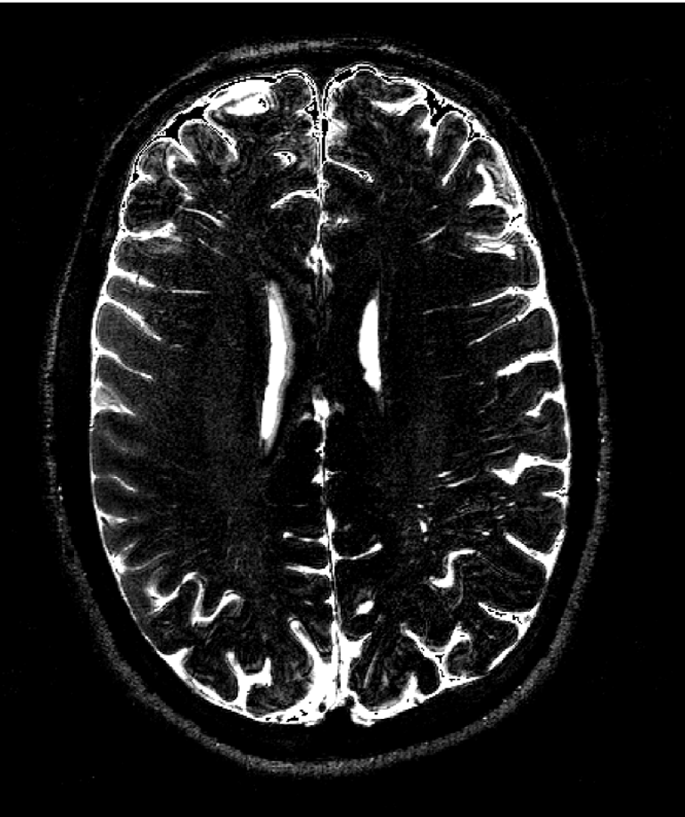
However, we have found that lower echo times = increase CSF visualization

Slide 13
Different areas of the glymphatic system may have different T2 values
800 ms
1000 ms
500 ms

Slide 14
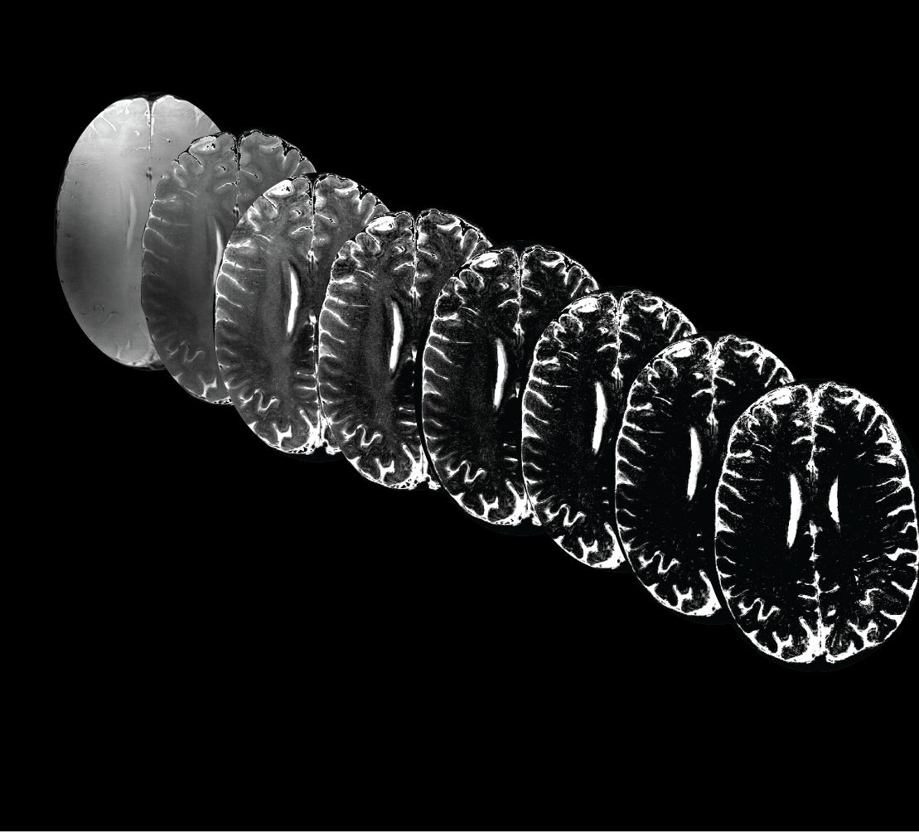
Multiple echo times

Slide 15
Multiple echo times
And a much longer scan time

Slide 16
Multiple echo times
And a much longer scan time
= better SNR

Slide 17
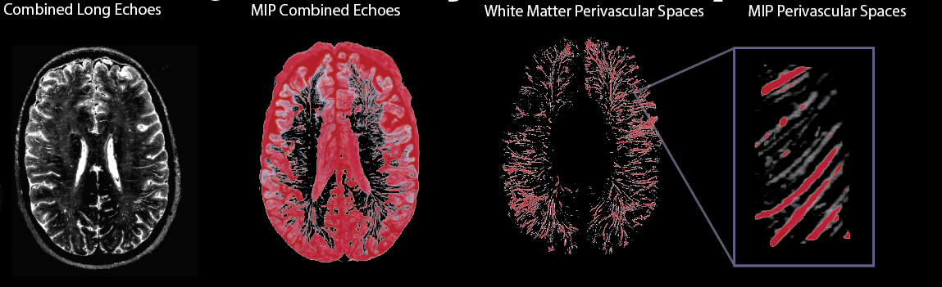
What do the images look like?
Fultz et al., 2025 ISMRM

Slide 18
What do the images look like?
Fultz et al., 2025 ISMRM

Slide 19
What do the images look like?
Fultz et al., 2025 ISMRM

Slide 20
How did we acquire the T2 maps?
Fultz et al., 2025 ISMRM

Slide 21
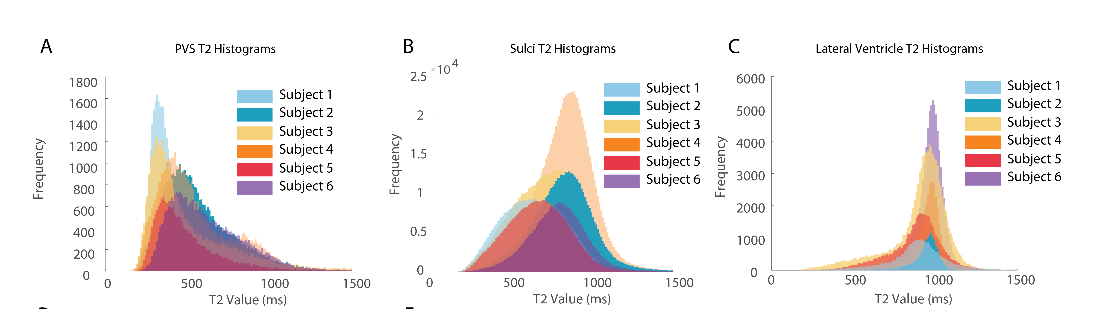
Decreased T2 PVS Values
Fultz et al., 2025 ISMRM

Slide 22
Decreased T2 PVS Values
Fultz et al., 2025 ISMRM

Slide 23
Decreased T2 PVS Values
Fultz et al., 2025 ISMRM

Slide 24
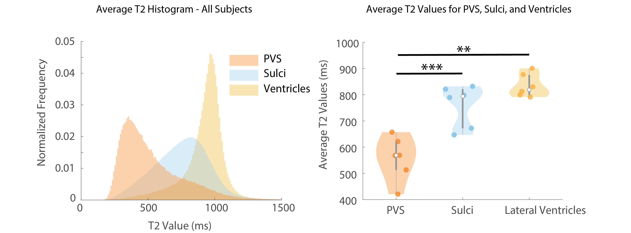
Decreased T2 PVS Values
Fultz et al., 2025 ISMRM

Slide 25
Decreased T2 PVS Values
Fultz et al., 2025 ISMRM

Slide 26
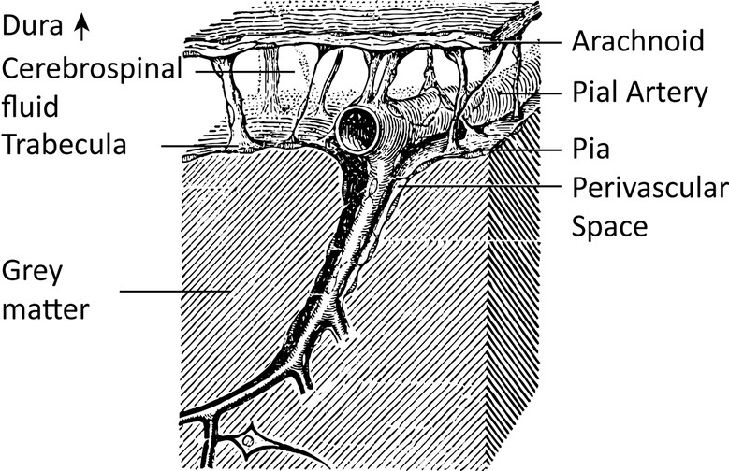
MRI-visible PVS are predominantly associated with arteries
Duvernoy, 1999
Fultz et al., 2025 ISMRM

Slide 27
MRI-visible PVS are predominantly associated with arteries
=
mixing occurring along arterial PVS?
Duvernoy, 1999
Fultz et al., 2025 ISMRM

Slide 28
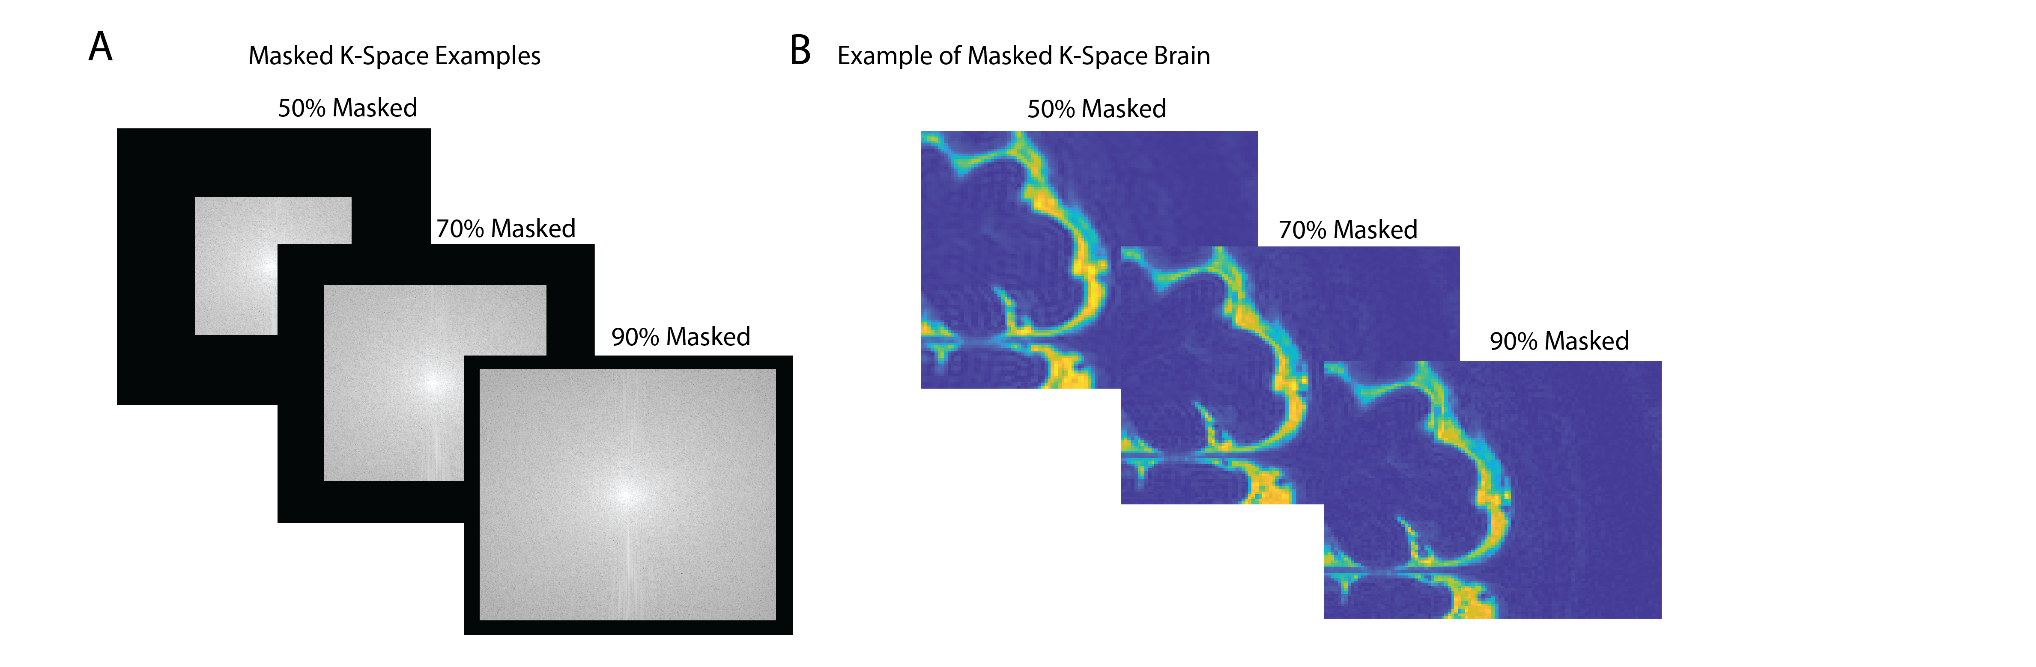
But what about partial volume effects?
Fultz et al., 2025 ISMRM

Slide 29
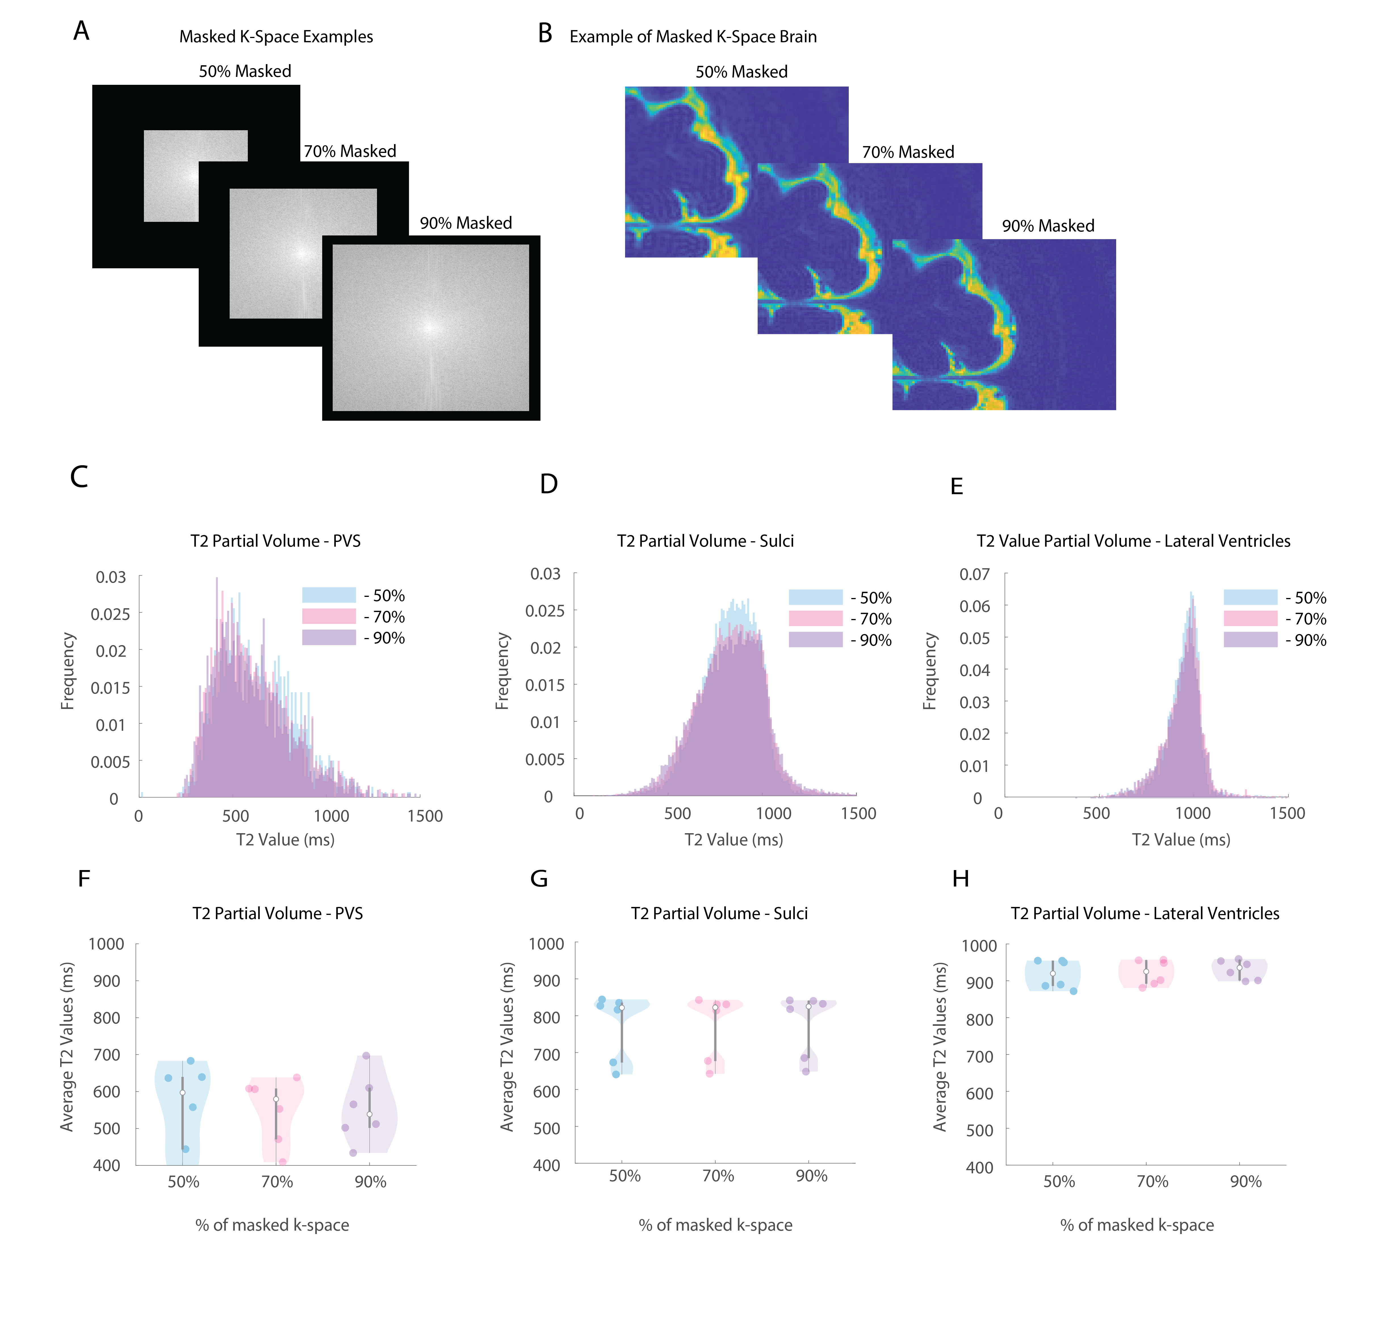
Partial voluming has no large effect on T2
Fultz et al., 2025 ISMRM

Slide 30
Partial voluming has no large effect on T2
Fultz et al., 2025 ISMRM

Slide 31
Do we see CSF ‘donuts’ beyond the ACA, PCA, and MCA?
Do these compartments have different CSF mobility and T2 values around major arteries and bridging veins/ACE points?

Slide 32
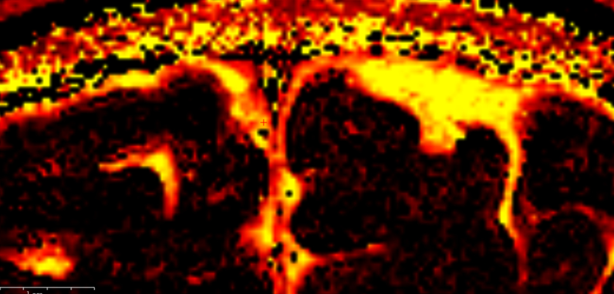
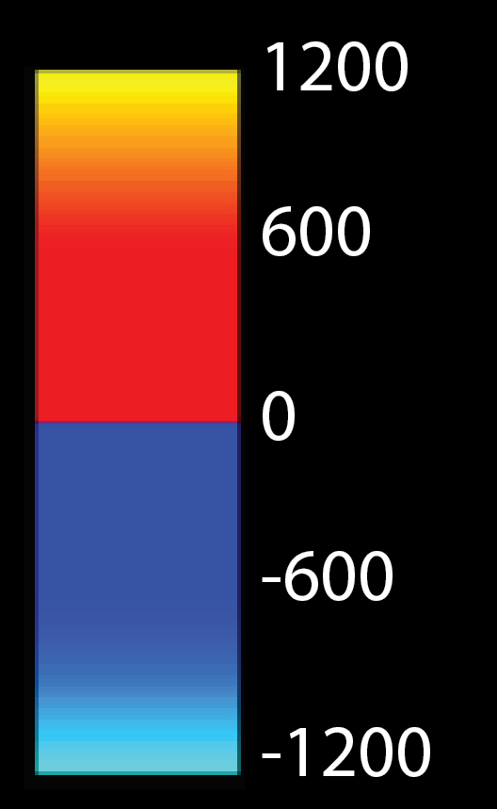
Different T2 values around veins vs. arteries

Slide 33
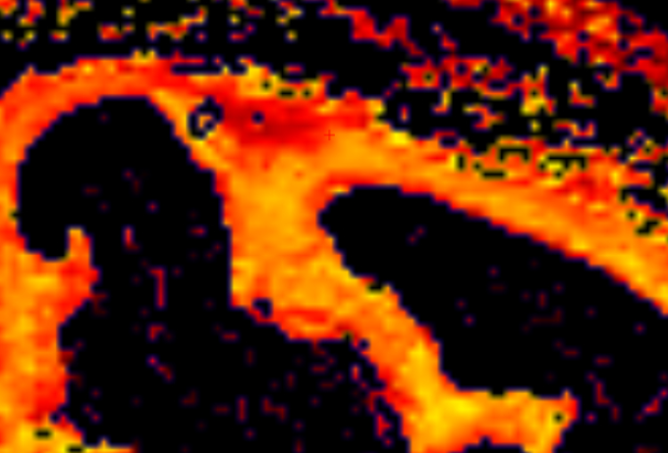
Different T2 values around veins vs. arteries

Slide 34
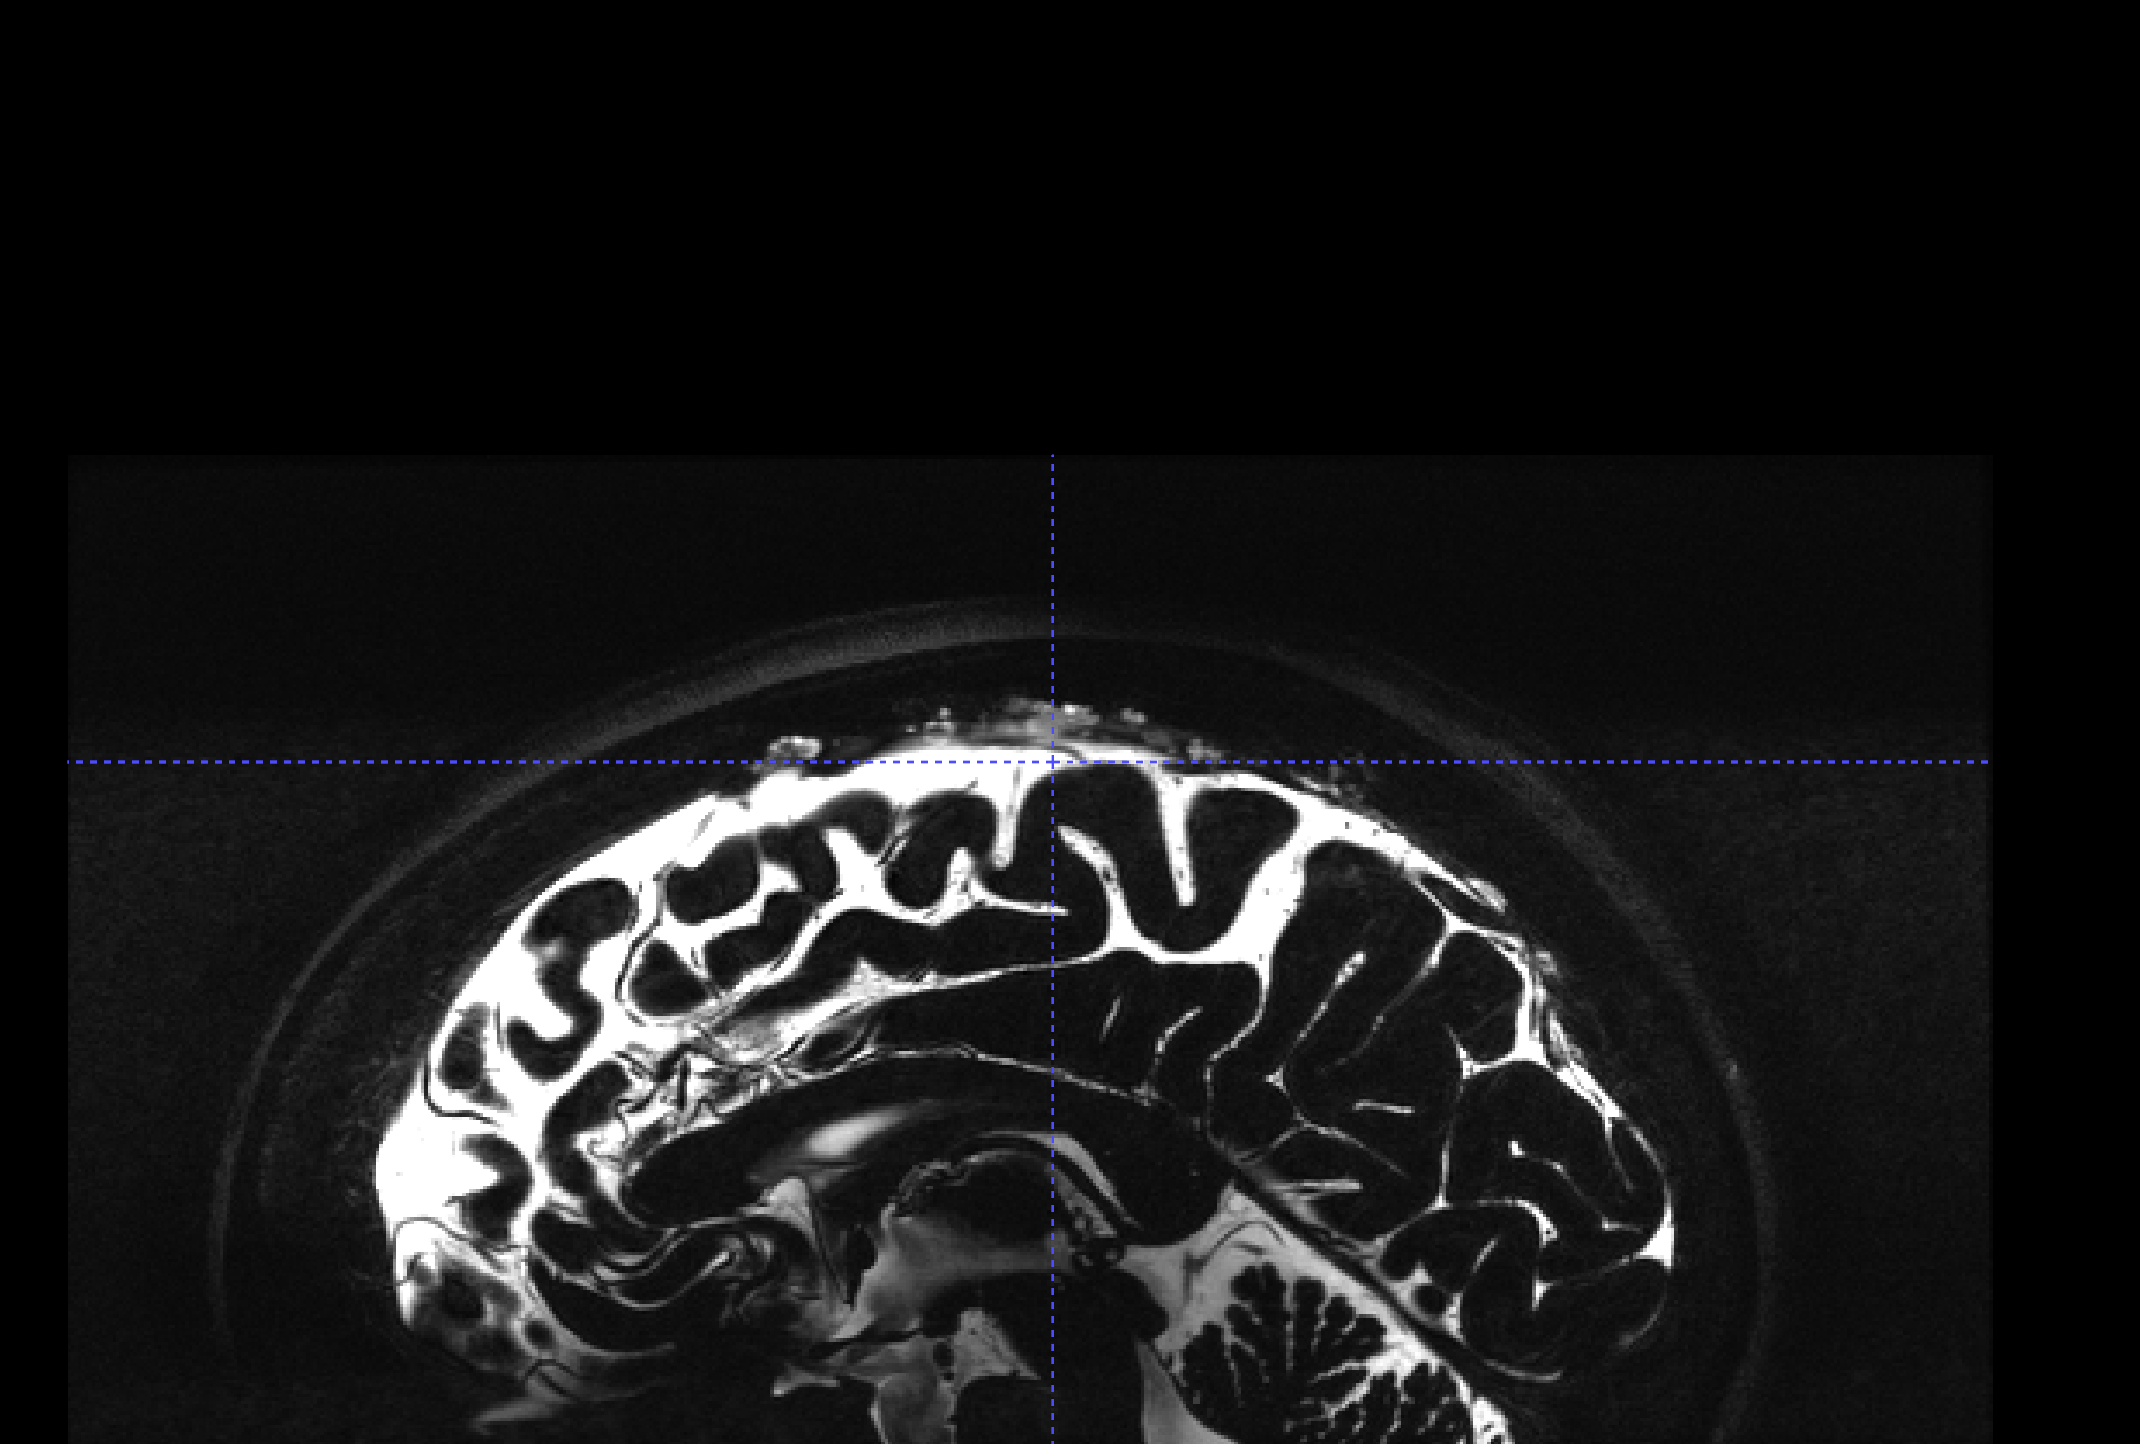
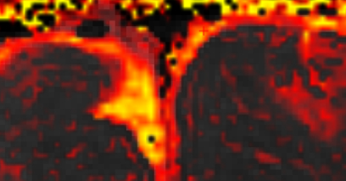
Different T2 values around veins vs. arteries
Notes:
Comaprison images with different pvs
T1 inflow affect in this vessel
Venogram and angiogram
Reslice 3dT1

Slide 35
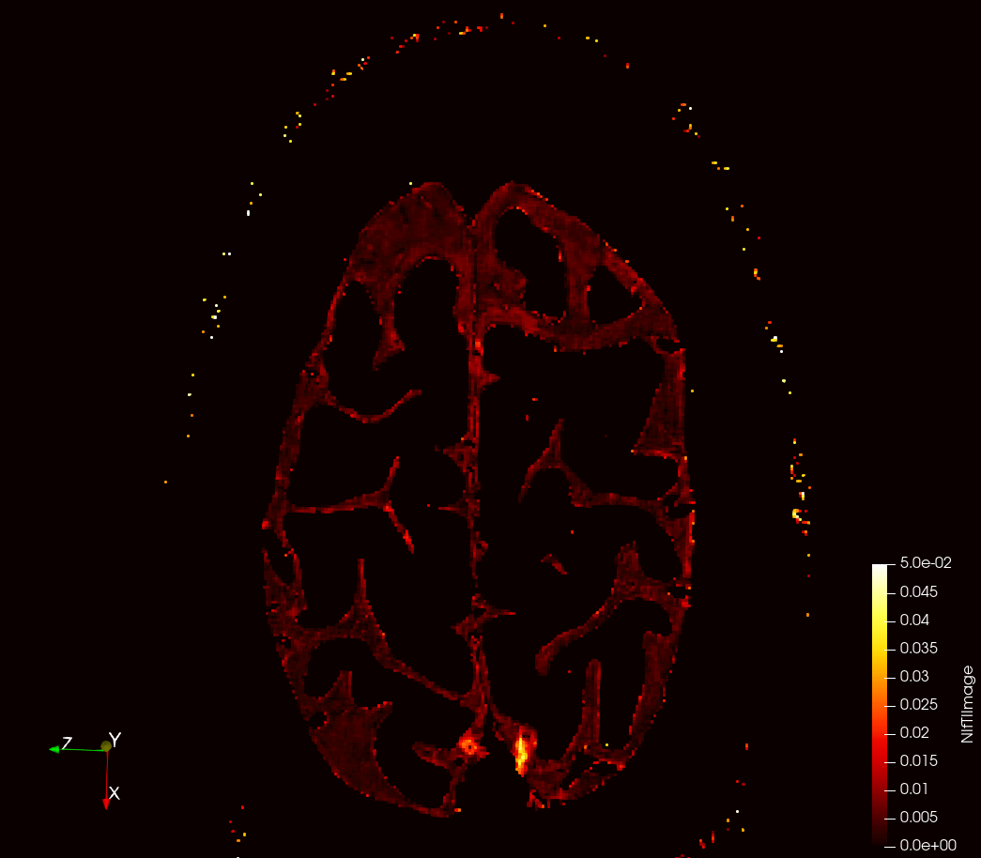
Donuts with high CSF-mobility

Slide 36
Donuts with high CSF-mobility

Slide 37
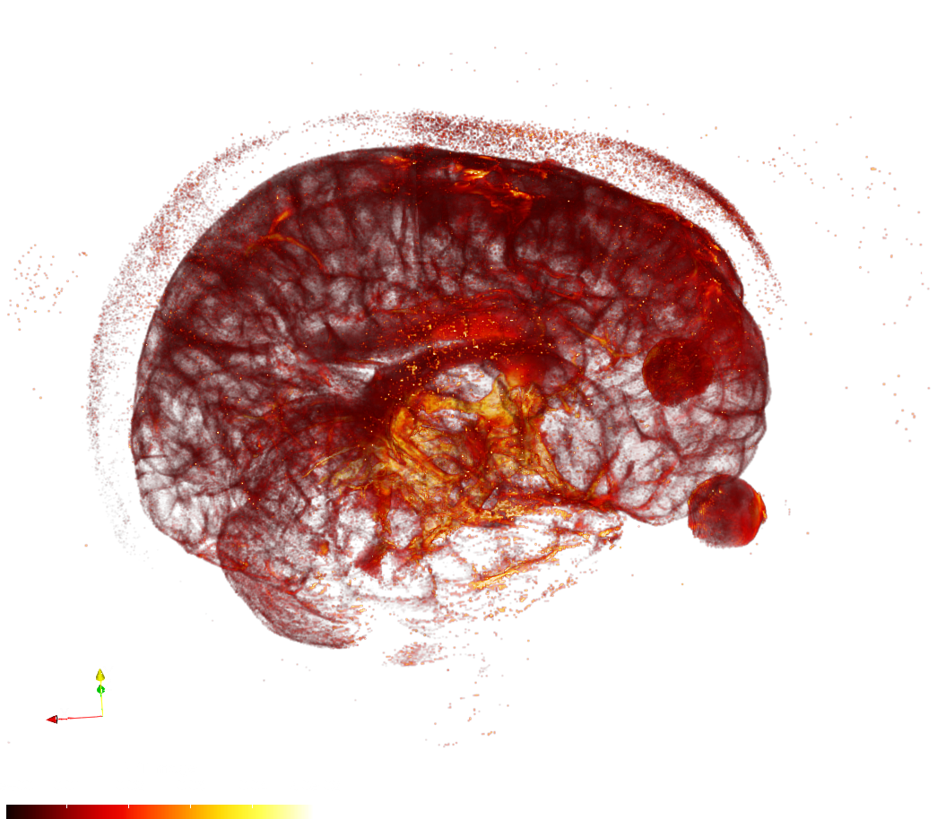
Donuts with high CSF-mobility ‘hubs’

Slide 38
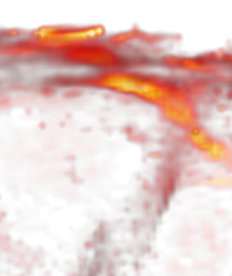
Donuts with high CSF-mobility ‘hubs’

Slide 39
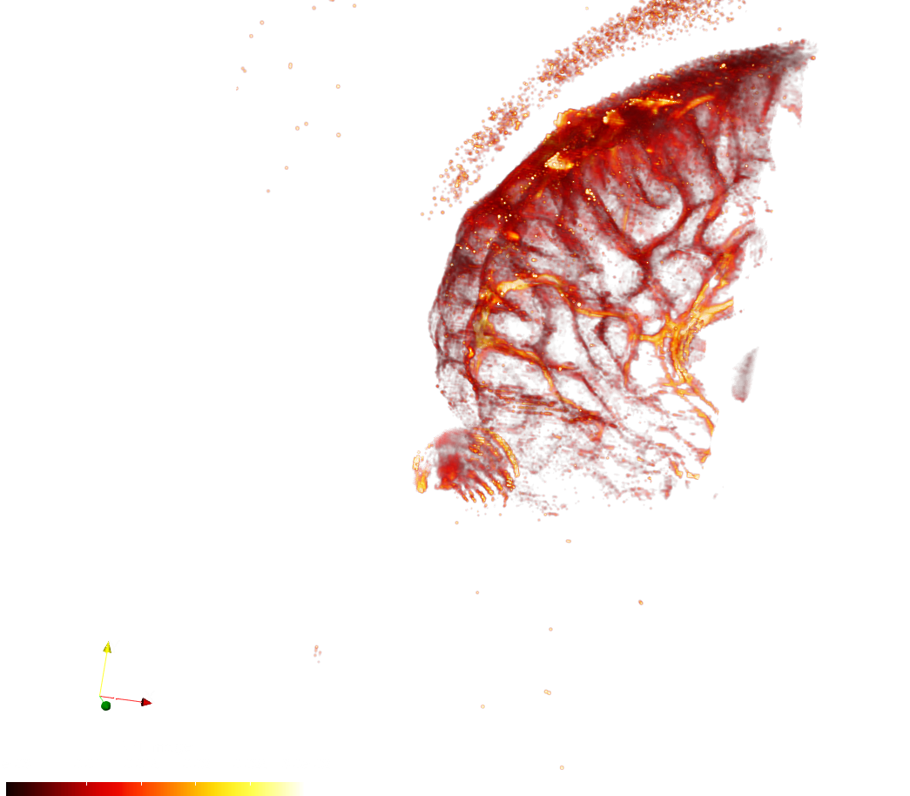
CSF hubs

Slide 40
ACE points

Slide 41
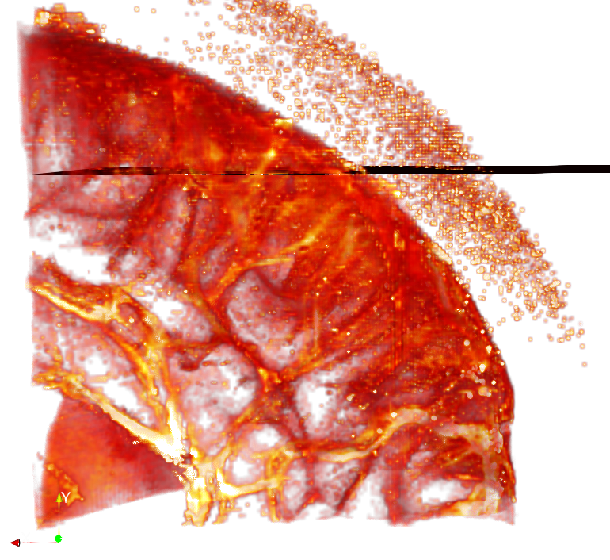
ACE points

Slide 42
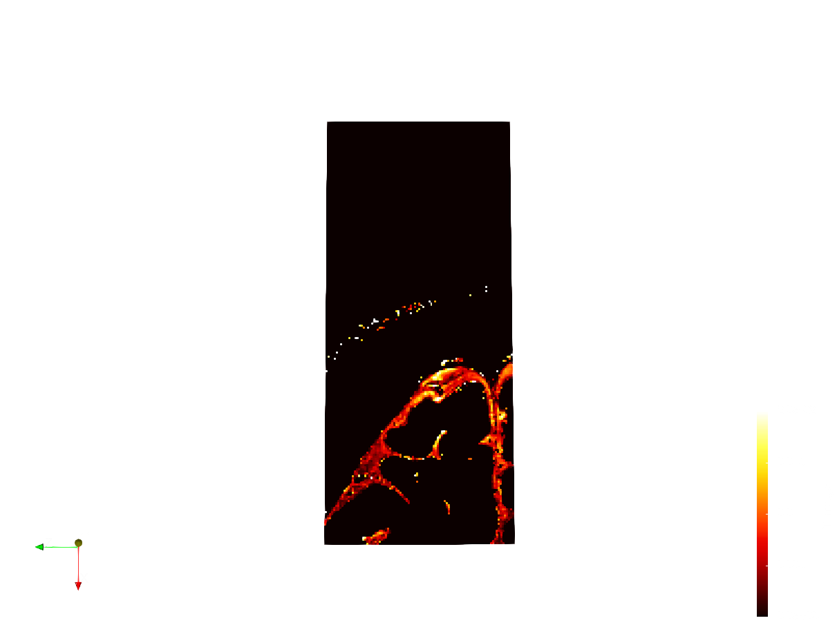
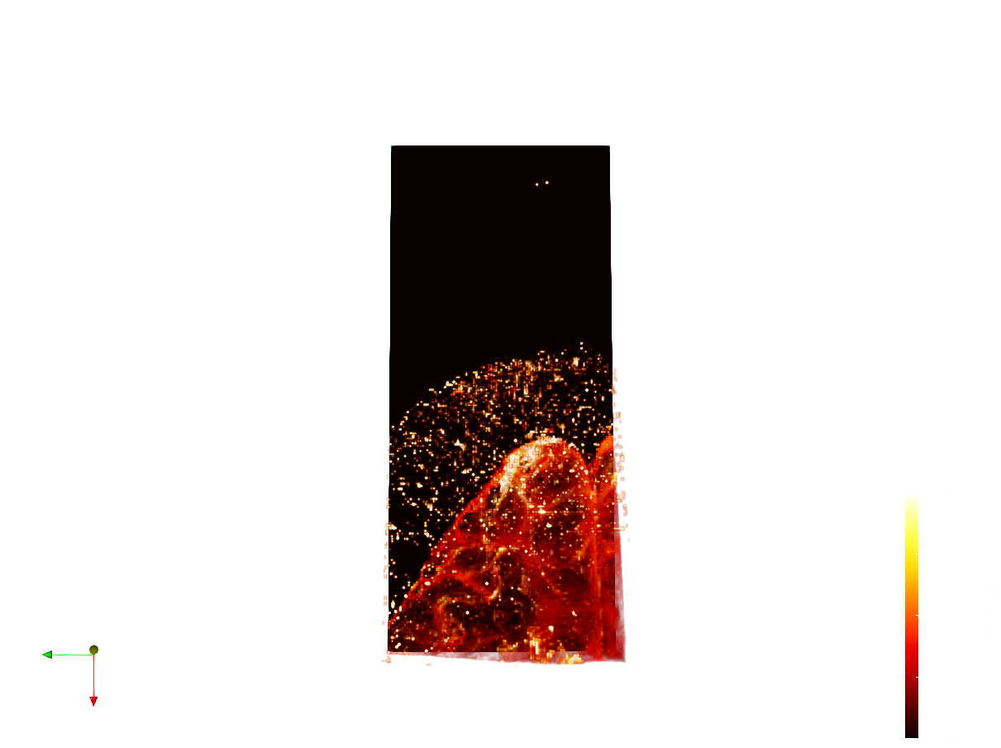
ACE points

Slide 43
Do these donuts have changes in composition and mobility around major arteries and bridging veins/ACE points?

Slide 44
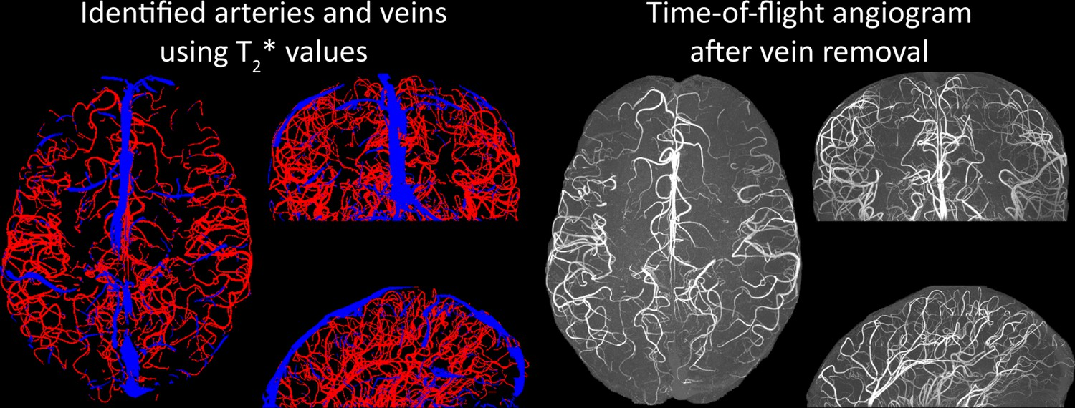
Parsing veins vs. arteries
Venogram
Angiogram
Bollman et al., 2022 eLife

Slide 45
Parsing veins vs. arteries
Venogram
Angiogram
T2* values thresholding
Neuroradiologist validation
Bollman et al., 2022 eLife

Slide 46
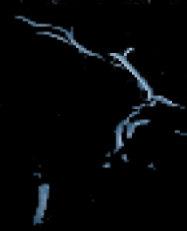
Segmenting bridging veins vs. arteries
Artery Automatic Segmentation Examples
Bollman et al., 2022 eLife

Slide 47
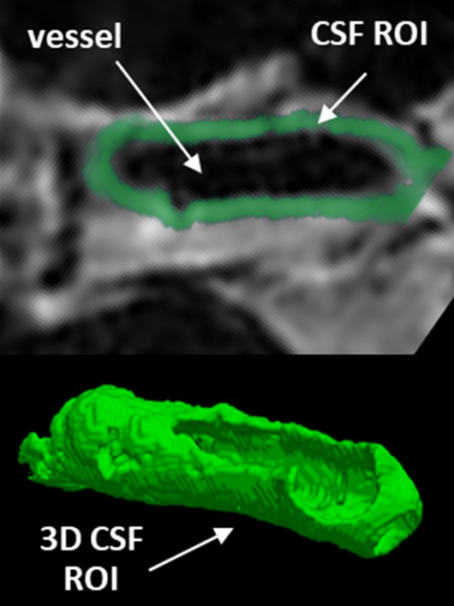
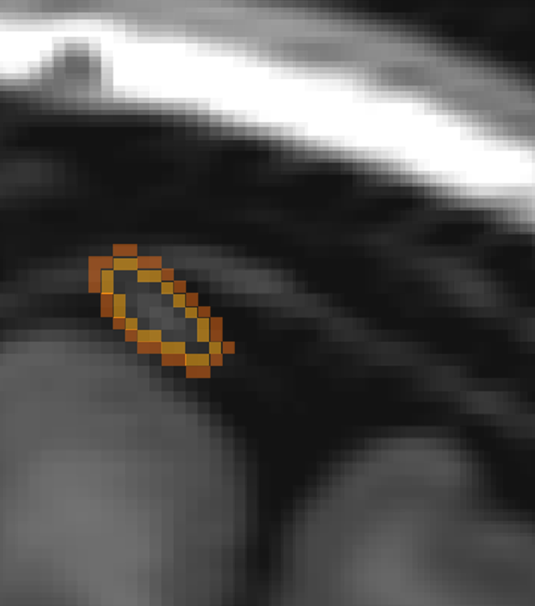

Segmenting bridging veins vs. arteries
Subarachnoid space around MCA
Segmentation Examples
Hirschler et al., under review

Slide 48
Next steps – technical hurdles
Parsing arteries, veins in a systematic way
Validating donuts – how big should we make our concentric circles?
Understanding how T2 values, ADC, FA, and vector directions are all related
Bollman et al., 2022 eLife

Slide 49
Next steps – patient populations
Cerebral Amyloid Angiopathy
Frontotemporal lobar degeneration
Bollman et al., 2022 eLife

Slide 50


Thank you!
Matthias van Osch
Lydiane Hirschler
Emiel Roefs
Martijn Nagtegaal
Maddalena Debiasi
Balazs Örzsik
Lena Václavu

